Slide 1
Crystallization
Lewis & Clark Workshop #1
© 2009, Michael S. Chapman

Slide 2
Why crystals?
Electrons scatter x-rays inefficiently (1 in 10¹⁶)
Dataset from one molecule ~ 100 trillion yrs
Solutions – average of all orientations
Solution scattering provides dimensions
Overall shape from moments of inertia
Radial density function
Not detailed structure

Slide 3
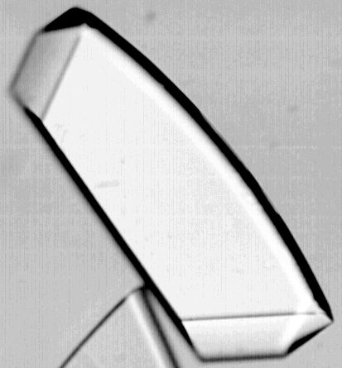
Crystals are molecular lattices / arrays
Crystals are arrays of ~ 10¹⁵ molecules with same orientation.
Variation in orientation 0.2 – 1.5°.
Scattering depends on direction
Structural detail
c
C
B
A
α
b
β
γ
a

Slide 4
Crystallization
Art; not completely scientific.
Only partially understood.
Thermodynamics
Phase diagrams
Empirical understanding – what works
… usually

Slide 5
What’s important to crystal quality?
Purity
Purity
Purity
Protein repeated exactly at each lattice point
Don’t want something else substituting…
Biochemically pure – goes w/o saying
Want > 99% purity; No chance if < 97%
Note – 1-3% contaminants difficult to detect
Need more than biochemical purity
Identical conformation.
Same post-translational modification.
Same proteolytic state.
Same chemical modification; eg. phosphates.

Slide 6
Crystals grow in 2 steps:
Nucleation - first aggregation.
Growth.
Thermodynamically distinct
Want a few nuclei to grow big
Use thermodynamics to understand the required conditions

Slide 7
Supersaturation
Solution at concentration > solubility
If at equilibrium → solid
But not at equilibrium
All macromolecular crystals grown from superstaturated solutions
Crystallization through controlled equilibration

Slide 8
Thermodynamics
ΔG_{g} = free energy of germination. Ideally...
ΔG_{g} = -kT(4π r³/V)ln β + 4π γ r²
k = Boltzman constant.
β = Supersaturation.
r = radius of nucleation.
V = volume of molecule in crystal.
γ = interfacial free energy: crystal vs. solution.

Slide 9
Thermodynamic implications
ΔG_{g} = -kT(4π r³/V)ln β + 4π γ r²
Nucleation – start of crystal growth
Small radius - 2nd term dominates.
At low supersaturation (β)
Positive – ΔG is unfavorable
High supersaturation needed to start crystal
Growth beyond critical size
Large radius – 1st term dominates
Always favorable

Slide 10
Implications for size
ΔG_{g} = -kT(4π r³/V)ln β + 4π γ r²
To maximize size
One (a few) nuclei
to which all available protein added
Want minimal β that only just nucleates
Finely tuned conditions
Experimental design
Initial β is non-nucleating
Slowly increase supersaturation

Slide 11
Crystallization vs. Precipitation
Molecules identically oriented on regular lattice
All molecules in optimal orientation/position
Can occur at lower supersaturation
Irregular aggregation
Molecules joining before they can find the optimal position/orientation
Occurs at high supersaturation
Occurs when supersaturation increased quickly

Slide 12
Phase diagrams
Supersaturation
Nucleation zone
Precipitation zone
Protein concentration
Metastable zone Crystals grow, but Nuclei form only infinitely slowly
Solubility curve
Under-saturation (protein remains soluble; crystals dissolve)
Precipitatant concentration (salt, PEG etc.)

Slide 13
Course of Crystallization Experiment
Metastable
Nucleation
Precipitation
Nucleates here
Increase [protein], [precipitant]
Crystal grows Sequesters protein [protein] drops
Protein concentration
Crystal stops growing @ solubility curve
Start w/ soluble protein (undersaturated or metastable)
Expt incr. [protein], [precipitant] Xtl grows again, until hits curve Repeats as follows solubility curve
[Precipitatant]

Slide 14
Experimental Determination of Phase Diagrams
Solubility curve at point when crystals dissolve
Requires large supply of crystals
Only after you know how to crystallize
Not much help in planning…
Requires so much protein that determined only for a few proteins.
These phase diagrams are useful for other proteins

Slide 15
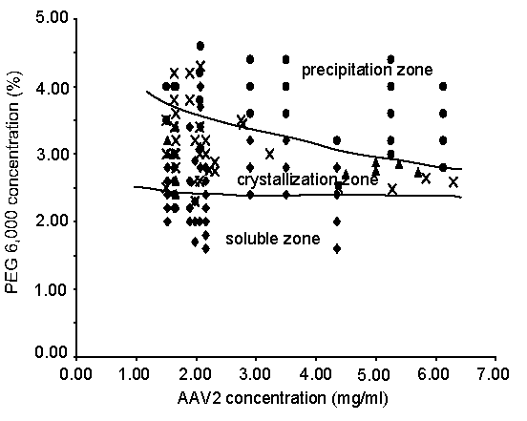
Generic phase diagrams
General shape used to interpret experiments
Plot conditions
→ precipitation
→ nucleation
Try to separate the phases w/ typically-shaped solubility curve
➔ Better guesses → trials that might → crystals
With more & more trials, improve phase diagram

Slide 16
What affects Phase diagrams?
Solubility NaCl
100
Precipitation NaCl
Precipitation KSCN
10
Lysozyme (mg/ml)
1
Solubility KSCN
1
2 M
Type of precipitant is most critical
Type of ion affects solubility
Need to try many
Lysozyme: both supersaturation and precipitation occur at higher NaCl concentrations than KSCN
-> wider crystallization window for NaCl.

Slide 17
Thermodynamics of Phase Diagrams
More nucleation @ high supersaturation.
Supersaturation drops as crystals sequester protein
less nucleation
A few large crystals.
Continued growth, requires increased supersaturation
Experiment needs to increase [protein] and/or [precipitant] (usually both)
Dialysis or vapor diffusion
Slow enough so [protein] drops w/ Xtl growth
Avoids further nucleation
Supersaturation
Nucleation zone
Precipitation zone
Protein concentration
Solubility curve
Metastable zone Crystals grow, but Nuclei form only infinitely slowly
Under-saturation (protein remains soluble; crystals dissolve)
Precipitatant concentration (salt, PEG etc.)

Slide 18
Methods for slowly increasing supersaturation
Vapor diffusion:
Hanging drops – most popular
Sitting drops – esp. robotic setup
Dialysis:
Microdialysis buttons – 3rd most popular
Zeppenzauer tubes
Capillary crystallization
Gels or free diffusion
Microfluidics
Protein soln
Precipitant soln.

Slide 19
Preparation for crystallization
Remove dust
Promotes excessive nucleation
Sterile filter (.22µ m).
Micro-centrifuge (10 min x 10,000 g)
Prepare in stable buffer
To be incubated for months
Azide to inhibit fungi
Consider protease inhibitors

Slide 20
Dialysis methods
Stretch dialysis membrane over capillary.
Attach w/ tubing.
Fill w/ (micro/Pasteur) pipette 10 – 300 μL.
Place in precipitant solution (1 – 3 mL) & Seal
Wait weeks for crystallization.
Inspection difficult
Not well suited for screening
Appropriate for large crystals w/ known conditions
When you have a bunch of protein

Slide 21
Principles of Vapor Diffusion
Sealed container
Vapor phase
Dynamic equilibrium
H₂O
H₂O
Protein + precipiant soln. Low osmotic pressure
Predominantly, water extracted from protein
Reservoir of precipitant at high osmotic pressure

Slide 22
Hanging drops – most popular
24 (or 96)-well culture plate
Test many conditions
Each – like mini-beaker
1 ml precipitant in “well”
Microscope cover slip (or tape) used as cap
Sealed on w/ vacuum grease
Protein drop hangs from coverslip
4 to 20 μL
Advantages
Small scale
Approaches equilibrium slowly
Crystals seen thro’ cover-slip w/ microscope

Slide 23
Hanging drop protocol
(Siliconize cover slips).
Grease rims of wells.
Put 1.0 ml precipitant solution in each well.
Prepare protein at ~1/2 precipitant concentration
Pippete 10µL protein solution to cover slip.
Add 10µL precipitant solution.
Invert cover slip over well & seal.
Carefully store plate.
Inspect w/ microscope.
Notes:
Possible break point here

Slide 24
Crystallization depends on…
Purity
Type of precipitant
Concentration of precipitant
pH
Protein concentration
Temperature
Ionic strength
Additives at low concentration
Ions, esp. divalent
Ligands, coenzymes
Detergents
(membrane proteins)
Organic co-precipitants
Other factors → success
Reducing agents
DTT, βME
Chelation of unwanted ions
EDTA?
Denaturants (low conc.)
(Dust-free; vibration free; controlled temperature)

Slide 25
Daunting combinations – Start w/ conditions effective w/ other proteins
1990 survey of precipitants:
60% proteins crystallized with salts;
NaCl; (NH₄)₂SO₄; K₂PO₄.
16% with organic solvents
Methyl-2,4-pentanediol (MPD)
15% with PEG (polyethylene glycol).
Now, much more than 15%???
MW 2000 – 6000
slower than salt.
Single most effective precipitating agent

Slide 26
Clues from related proteins
BMCD - Biomolecular Crystallization Data Base (NASA, NIST)
Conditions copied from literature.
(With some errors!)
Protein concentration, salt, PEG, pH...
Look for your type of protein.

Slide 27
Screens (for when you haven’t a clue)
Derived from BMCD data base
What 50 sets of conditions would get you close to the largest # of previously crystallized proteins?
Sung Ho Kim, Alex McPherson...
Can purchase pre-made solutions, covering
Precipitants: salts, PEGs (var MW), MPD…
pHs – beware, some not as labeled
Additive ions
Organic co-precipitants
Special screen kits for membrane proteins, immunoglobulins… many screens now available
High chance of a lead – microcrystals etc.
Lead conditions need to be optimized

Slide 28
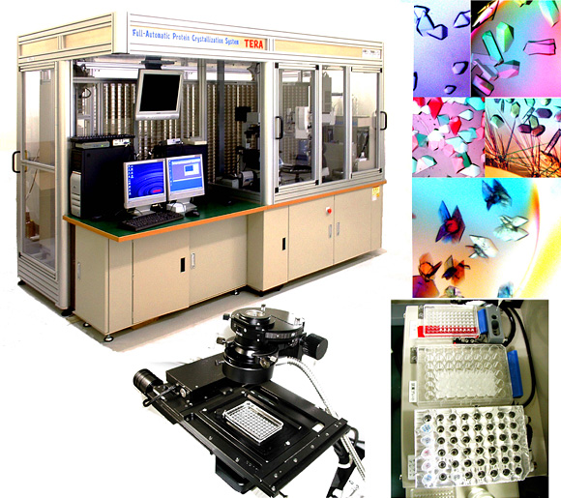
Automation and Robotics
Advantages
High throughput
Substitute for graduate students
Low volume
Technologies:
Oil drop;
capillary microfluidics;
sitting / hanging drop
Challenge
Pattern recognition
Disadvantage
Cost: $50,000 - $1M+
Xtal Biostructures Inc. & others – service $500-$2,000 (or free…?)
10 μl to test several hundred conditions
Photographed daily for 2+ weeks
Summaries provided over internet

Slide 29
Automation components
Drop-setting
Vapor diffusion
Hanging or sitting drop
Fast, accurate
Nanoscale (2-10 nL)
Pre-formed array of conditions
Screens
Commercial arrays
$100s
Dozens available
Robotic liquid handling
$120,000
Visualization
Microscope $10k + time
Polarization
+ camera / xy-stage ($50k)
Multi-plate storage / robot - $120,000
Fluoresence
Array optimization
Integration – fully automatic - $1M+
Services...

Slide 30
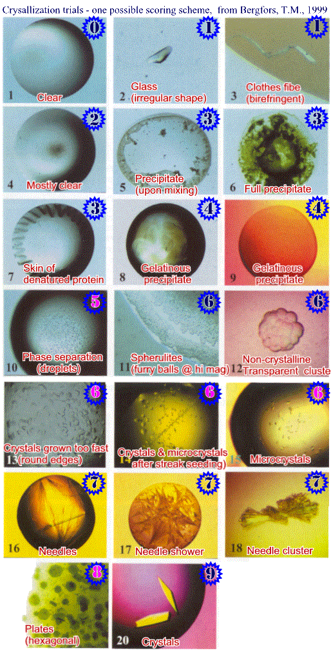
Types of results - scoring
Rarely get single crystals on 1st attempt
Other results can indicate where to try next
Some results more encouraging than others
Precipitates
Flocculent or granular?
Crystalline
1D fiber, needle, plate…
Various scoring systems

Slide 31
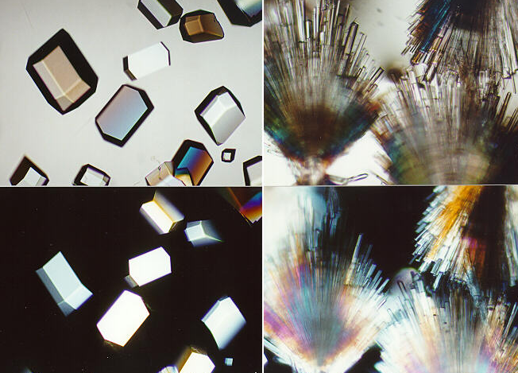
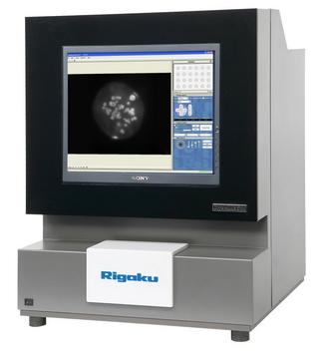
Assessing crystals
Size (reticule)
Perfection
Cracks / domains
Protein?
Crossed polaroids
L-amino acids
Polaroid rainbows
Fluorescence
Optics
Izit ~ Coumassie
Softness

Slide 32
Improving crystals – Systematic screens
Split each of N variables into S fine steps
E.g. [PEG] – 10 to 15% in 0.5 % steps
E.g. [Protein] – 5, 10, 15 mg/mL
pH in steps of 1.5 units
Additives
Test one variable at a time
Perhaps a combination of conditions is required
May never see it
Test combinations

Slide 33
Testing combinations – Factorial experiments
Full factorial – all combinations – S^{N}.
Simplest - Perhaps when only one or two variables
Needs much protein
Many experiments
Incomplete factorial
Random subset of all combinations
About (NS)² trials
Statistical analysis to indicate most important variables
more efficient

Slide 34
Kinetic considerations in crystal quality
Nucleation rate: J_{n}:
J_{n} = B_{s} exp (-ΔG_{g}/kT)
B_{s}: product of solubility and kinetic parameter.
Soluble protein: nucleates quickly (equilibrium).
Less soluble: slow kinetics allows protein to be concentrated by dialysis or vapor diffusion.
Nucleation at high supersaturation
➔ shower of small crystals.
Optimize solubility eg pH far from pI.

Slide 35
Optimal Rate of Crystal Growth is a balance
Fast crystallization
takes place at lower supersaturation
→few big crystals.
→ local concentration depletion
→ crystal defects
Control thro’ solubility, drop size, temperature…
Temperature complicated
J_{n} = B_{s} exp (-ΔG_{g}/kT)
Affects kT
Also affects solubility (up or down?)
Try experimentally 4, 20°C
Large drop has lower surface-area:volume ratio
Slower equilibration by vapor diffusion

Slide 36
Conclusion
Many things to try
One of the rate-limiting steps
Good crystals greatly facilitate struct. Determin.
1st crystals may not be the best possible
Optimize several types of conditions
Read a good book before attempting crystallization
My favorite: Ducruix, A. and R. Giegé, Eds. (1999). Crystallization of Nucleic Acids and Proteins. 2nd Ed., The Practical Approach Series. Oxford Univ Press.

