Slide 1
Diffraction – Theory & Data Collection
Lewis & Clark Workshop Macromolecular Crystallography © Michael S. Chapman

Slide 2
X-rays
Part 1:

Slide 3
Definitions.
i
Electromagnetic waves.
Amplitude (A) varies as cosine of distance from origin (O). |F|
Wavelength = λ, split into 360º or 2π radians.
Phase (φ or α)
Measured:
origin ◊ +ve peak
angle from ℜ-axis (anticlockwise)
O
|F|
φ
R
π
π
2π
3π/2
φ
φ
O
π
2π

Slide 4
Why X-rays?
Atoms scatter X-rays in all directions.
Phase change is exactly π rad.
Measure sum of scattering.
Path length through 2nd atom differs.
φ_{atom 1} ≠ φ_{atom 2} → interference.
λ
Small atom 1:
Some X-rays scattered
A
Big atom 2:
More X-rays scattered
Detect the sum
Notes:
Questions: (1) Draw incoming ray for 2nd atom;
(2) Scattering from second atom… how does it differ from 1st?
(3) What will we see?
(4) Sum the waves.

Slide 5
The optimal wavelength
Make much longer
Scattered waves more in phase
Less interference
Less dependent on structure

Slide 6
X-rays have wavelengths close to optimal
Max. interference: path length difference ≈ λ.
λ ~ interatomic distances.
Choose 0.7 Å ≤ λ ≤ 1.8 Å
Commonly λ ~ 1.5 Å ~ C--C bond.

Slide 7
Why Diffraction? – Crystallography in a nutshell
X-ray refractive indices close to 1.0.
~No refraction or reflection → No lenses.
Uncharged →No electrostatic lenses like E.M..
Left with diffraction!
X-rays scatted & reconstructed computationally.

Slide 8
Atoms or Electron Density
What is scattering the X-rays?
Atoms
Not exactly – electron clouds
Image is electron density
Atomic Structure is an interpretation…
Nuclear positions consistent with electron density.
Exptl error in density can → difficult interpretation.
Notes:
Questions: (1) Draw incoming ray for 2nd atom;
(2) Scattering from second atom… how does it differ from 1st?
(3) What will we see?
(4) Sum the waves.

Slide 9
Crystallography in a nutshell
Microscopy without the lens…
Lens would physically “sum” scattered waves.
Crystallographers have to “sum” waves computationally.
Measure intensity in each direction.
Amplitudes not enough
Phases – synchronization of waves
How they line up, how far peaks lag behind each other.
Can’t be measured directly – “Phase Problem” Challenge.
Notes:
Questions: (1) Draw incoming ray for 2nd atom;
(2) Scattering from second atom… how does it differ from 1st?
(3) What will we see?
(4) Sum the waves.

Slide 10
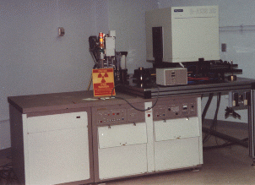
Conventional sources of radiation
High voltage filament
e⁻ acceleration → X-rays.
Fire electrons into target.
Vacuum
Be window
Copper target
X-rays
Water cooling

Slide 11
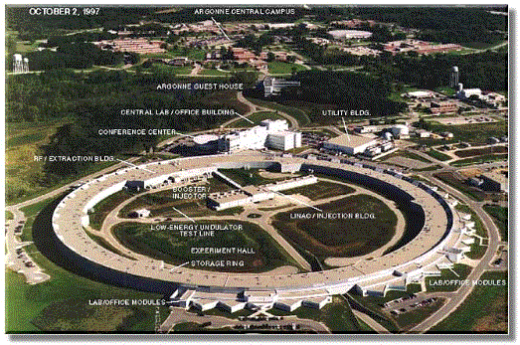
Synchrotrons
e⁻ accelerated in circular path
Relativistic speeds
Energy (X-rays) tangential
High intensity
More data before damage spreads
Tunable wavelength
Phasing
Shared multi-user facilities

Slide 12
Preparation of X-rays
Fine parallel beam
Collimator
Focusing mirrors
Monochromatic (single wavelength)
1.51 Ǻ or 0.91 Ǻ or adjusted 0.7 – 2.0 Ǻ
Monochromator
Focusing mirrors

Slide 13
Interaction of X-rays with samples
Absorption (fluorescence)
Mostly minor annoyances
Scattering
Important – because no lenses for imaging
Need understanding of how atomic structure affects the scattering of materials
Elastic (Coherent aka Thompson) scattering
No loss of energy (λ unchanged; Δφ = π).
Dominates diffraction.
Inelastic (Incoherent aka Compton) scattering
Collision w/ e⁻ (energy transfer)...
Background scattering

Slide 14
Electromagnetic waves.
E_{i} = E_{Oi}[cos 2πν(t - x/c) + i sin 2πν(t - x/c)]
E_{i} is field @ time t, position, x from origin O.
i = √-1 ; E_{i} represented as complex vector.
Only amplitude observed, but
complex form allows addition of waves.
By de Moivre's theorem (e^{ix} = cos x + i sin x):
E_{i} = E_{Oi} exp 2πiν(t - x/c)
Field accelerates a charged particle with frequency ν.
Max. acceleration as particle passes node @ max E_{i}.
Thus (electron) particle displacement π/2 from E_{i}.
The accelerating orbital electron initiates a second electromagnetic wave with a 2nd phase change of π/2.
E_{i}
E_{Oi}
Notes:
Have students draw incident electromagnetic wave, oscillation of electron orbitals.
Students to draw scattered ray, offset by pi/2.

Slide 15
Diffraction by Fourier Transform
Part 2

Slide 16
Interference of Scattered X-rays
O’
s
s/λ
s_{o}
r*
Q
r
B
θ
A
θ
O
s_{o}/λ
Scatter from O and O' related by vector r.
Path-difference:
|OA| + |OB| = |r|cos AÔO' + |r|cos BÔO' = r · (s - s_{o})
s_{o} unit vector along incident direction.
s unit vector along scattered direction.
Δφ = (2π/λ)r · (s - s_{o})
Notes:
Notes (1) Figure 3.2 of Giacovazzo. Equation (1): check happy w/ dot product. Equation (2): formal proof of why no interference for |r| < λ.

Slide 17
Interference of Scattered X-rays (2)
O’
s
s/λ
Δφ = 2πr·r*
where r* =(s - s_{o})/λ
r*
units: reciprocal distance;
vector in reciprocal space.
Consider plane/line OQ ⊥ r* :
|r*| = r* = 2 sin θ/λ
Angles of incident and scattered beams to OQ are both θ.
Imagine beam reflected from plane OQ ⊥ r*.
s_{o}
r*
Q
r
B
θ
A
θ
O
s_{o}/λ
Direction of r* comes from eqn 2 of this page
Notes:
Notes Figure 3.2 of Giacovazzo. Equation (2): Reciprocal space is figment of imagination. Emphasize reflection is imaginary, but central to diffraction theory.

Slide 18
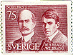
William & Lawrence Bragg
Max von Laue demonstrated wave character of x-rays
Diffraction by crystals
Braggs – father & son
1913 - 1914
Realized that x-ray scattering could be imagined as reflection from planes
Solved NaCl.
Nobel prize 1915
Notes:
William Bragg educated @ King William’s college, IoM, then Cambridge where he read Mathematics. Research in several fields, but worked on x-rays for only 2 years with his son. For the rest of the 1st world war, he worked developing sonar for submarines & never came back to diffraction. Lawrence Bragg stayed in crystallography and he led the Cavendish laboratory in Cambridge, hiring Kendrew and Perutz, the forefathers of macromolecular crystallography.

Slide 19
Atomic Structure Factor eqn.
_{ABS}E_{d} = E_{Od} exp 2πi ν(t-r/c)-iπ
From last lecture
_{REL}E_{Od} exp 2πiν(r/c) = _{REL}E_{Od} exp 2πir/λ
Substitute Δφ = r/λ (= 2πr·r*)
& sum over N scattering points:
Let r_{j} be center of j^{th} atom.
F(r*) = Σ^{N}_{j=1} A_{j} exp 2πi r*·r_{j}
Consider scattering relative to a free electron.
By Convolution Theorem (later):
F(r*) = Σ^{N}_{j=1} f_{at,j}(Z, r*, U) exp 2πi r*·r_{j}

Slide 20
Atomic Structure Factor eqn.(2)
F(r*) = Σ^{N}_{j=1} f_{at,j}(Z, r*, U) exp 2πi r*·r_{j}
f_{at} ≡ atomic scattering factor ≡ FT isolated atom (later):
Depends on # electrons, thermal vibration.
Tabulated theoretical or experimental values.
Can be approximated roughly by spherically symmetric Gaussian.
Scattering ≡ FT(molecule)

Slide 21
Scattering by elements of electron density
F(r*) = Σ^{N}_{j=1} A_{j} exp 2πi r*·r_{j}
Let r_{j} be small element of electron density, ρ.
Consider total scattering:
F(r*) = ∫_{V} ρ(r)exp 2πir*·r dr
Right-hand side ≡ FT(ρ).
Structure determination:
measure amplitude
determine phase throughout (continuous) function, F(r*)
compute inverse FT → electron density:
ρ(r) = T⁻¹[F(r*)] = V* ∫_{V*}F(r*)exp -2πi r*·rdr*
Notes:
In principle structure determination is THAT simple. In practice, very difficult to determine the phases.

Slide 22
Fourier Transforms (1)
If f(x) is piecewise integratable, it can be approximated by a Fourier transform (T):
f(x) = ∫_{x*} F(x*) exp -2πi x·x* dx*
F(x*) is
a "Fourier coefficient“
given by an inverse Fourier transform (T⁻¹):
F(x*) = ∫_{x} f(x) exp 2πi x·x* dx
Both F, f may be complex.
Crystallographically: ρ = R(f).
Designation of forward, inverse is conventional for crystallography. As both are Fourier transforms, they have corresponding mathematical properties.
Do not confuse this f (general function) with f – the atomic scattering factor
Notes:
When we say integratable, it need not be algebraic. So the function can include discontinuities.

Slide 23
Fourier Transform of a Step Function
g
-g < x < g: f(x) = c; else f(x) = 0
F(x*) = ∫_{-g}^{g} (c).exp 2π i x*x dx
F(x*) = c∫_{-g}^{g} cos 2π x*x dx + i c∫_{-g}^{g} sin 2π x*x dx
f(x) is even function, so 2nd integral = 0:
F(x*) = c[(sin 2πx*x)/2πx*]_{-g}^{g}
= c((sin 2πgx*)/2πx* -(sin -2πgx*)/2πx*)) = c(sin 2πgx*)/πx*
Note wider step (large g)
--> short period of F(x* ).
Generally: large objects in real (direct) space are small in reciprocal (Fourier transform) space et vice versa.
π/g
0
Notes:
Step Function Draw step: point out symmetry: Prompt for even function. Prompt for 0 2nd term, and for integral of cos. End: Sinch function.
Will return to step function later when consider functions repeated on a regular grid.
See the class notes for the Fourier transforms of a Gaussian function and a 3-D spherical step function.

Slide 24
Infinite 1-D lattice -- Lessons
FT(lattice) = (lattice), in reciprocal space.
Spacing of reciprocal lattice inversely proportional to real lattice.
Diffraction of crystals → relatively strong diffraction spots and insignificant intensity between spots.
Need only use lattice points --> discrete transform.

Slide 25
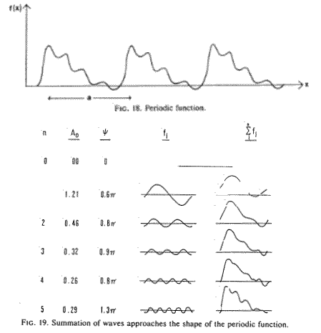
Fourier Series
FT can approx. any piecewise integratable function.
Coefficients each have amplitude and phase
Effect of truncation

Slide 26
Electron Density Equation
ρ(x) = 1/V Σ_{h}F_{h}exp -2πi h·x
ρ(x,y,z) = 1/V Σ_{h=-∞,+∞} Σ_{k=-∞,+∞} Σ_{l=-∞,+∞} [A_{hkl}cos{-2π(hx+ky+lz)} + i B_{hkl}sin{-2π(hx+ky+lz)}]
Where F = A + i B;
h = (h,k,l), “Miller indices”;
x = (x,y,z) r.h. unit cell vectors
V is unit cell volume
A = |F| cos φ; B = |F| sin φ
|F| is structure factor amplitude (measured experimentally).
φ difficult to determine → “The phase problem”
Notes:
Calculate electron density from structure amplitudes (and phases)

Slide 27
Structure Factor Equation
F_{h} = 1/V* Σ_{x}ρ(x)exp 2πi h·x*
F_{hkl} = V Σ_{x=0,1} Σ_{y=0,1} Σ_{z=0,1} ρ(x,y,z)[cos2π (hx+ky+lz) + i sin2π (hx+ky+lz)]
Where x = (x,y,z) are
right-handed coordinates
measured in fractional units
fraction of unit cell (a,b,c)
V = a·b∧c.
Note symmetry w/ electron density equation

Slide 28
Atomic Structure Factor Equation
F_{hkl} = Σ^{N}_{j=1} f_{at,j} exp 2πi h·x_{j}
F_{hkl} = Σ^{N}_{j=1} f_{at,j} [cos 2π(hx + ky + lz) + i sin 2π(hx + ky + lz)]
Summing over atoms instead of grid points
Computationally less efficient if many atoms
Structure factor equation can use FFT

Slide 29
Lattices

Slide 30
Crystalline Lattices
Previously learned…
Diffraction pattern = Molecular transform sampled at reciprocal lattice points.
Reciprocal lattice = FT or diffraction pattern from crystalline lattice
Why understand real-space lattices?
→ prediction of location of diffraction spots.
→ interaction of neighboring molecules in crystal lattice
(molecular symmetry)

Slide 31
Lattices
Grid: equally spaced || lines (planes).
Choice of origin is arbitrary.

Slide 32
Unit Cells
C
Axes labeled (a, b, c)
by convention.
Right-handed system
Specify 3 vectors
a, b, c.
or 6 parameters
3 lengths + 3 angles
a, b, c + α, β, γ
α = angle between b and c axes etc..
Faces labeled A,B,C
with A intersected by a-axis etc..
c
A
b
B
α
β
γ
a
Notes:
Convention: Don't worry.
Right-handed: demonstrate.
Vectors describe unit cell.

Slide 33
Lattice Planes in 2-D
Line can be drawn between any 2 grid points.
Parallel lines pass through every grid point.

Slide 34
Bragg's Law (Real space) 1
Previously showed scattering like reflection from plane through scatterer.
Path length same for all points on plane:
All points scatter in phase.
Planes containing many identical scatterers have strong scattering (Lattice planes).

Slide 35
Bragg's Law -- Real space 2
Consider || planes P₁, P₂, ... P_{j}, P_{j+1}, ... P_{N}.
Path differences: Δ{P₂ - P₁} = Δ{P_{j+1} - P_{j}} = 2d sinθ
2
1
1’
P₁
2’
P₂
θ
θ
θ
d
θ
θ
Σ_{planes} scatter much larger when "in phase".
... path difference = 2dsinθ = nλ; (n=1)
f₄
i
α
i
f₃
f₂
f₃
f₂
F
Non-integer n
α
α
f₁
Integer n
f₁
f₄
F
R
R

Slide 36
Bragg's Law -- Reciprocal lattice
Diffraction only at integral path difference = 2dsinθ = nλ
Spots spaced regularly
Lattice in 3-D
This reciprocal lattice has spacing inversely proportional to crystal lattice spacing
Directions of axes depend on crystal
Let ~d₁₀₀ be unit vector || d*₁₀₀:
~d₁₀₀ = b∧c/(|b||c|sinθ)
d*₁₀₀ = |d*₁₀₀| ~d₁₀₀
|d₁₀₀| = V/(|b||c|sinθ) = 1/|d*₁₀₀|
d*₁₀₀ = 1. b∧c /(d₁₀₀ |b||c|sinθ) = b∧c/V ≡ a*
(Remember that we are using bold for vectors)
Notes:
Notes: Eqn 1: (Cross product divided by the magnitude of the cross product.)
Eqn 3: (Unit cell volume divided by the area of bc gives the perpendicular distance between adjacent planes.)
Eqn 4 – try to draw a unit cell volume, the parallel planes and the interplanar spacing.

Slide 37
Bragg's Law – Graphically -- Implications
Plane
Plane
O
O
θ
θ
C
C
2θ
2θ
θ
θ
d*_{-1,0,5}
d*_{-1,0,5}
X
X
Diffracted
beam
X-rays
X-rays
P
P
For any point, P, on the the surface of the sphere, OP = 2sinθ/λ.
OP = d* is a solution to Bragg's law
Diffraction only at reciprocal lattice points
… when sphere and lattice point superimpose
Scattering || CP
Notes:
Notes: OP: show that this is expression of Bragg's law.

Slide 38
Bragg's Law Graphically – Ewald construction
For given wavelength and crystal orientation…
only those relps on surface of the
“sphere of reflection”
→ observable reflections.
To see more spots, rotate crystal:
Rotates reciprocal lattice through sphere
→ reflections pass through sphere

Slide 39
Resolution
l
film
crystal
D
2θ
Let D_{max} be the distance of furthest spot from the direct beam.
Let d_{min} be its interplanar spacing.
d_{min} = λ/(2sin θ_{max}) = λ/2sin{½tan⁻¹(D_{max}/l)}
d_{min} is de facto resolution limit.
Note d_{min} refection at max, i.e. farthest from beam.
Notes:
Explain microscopic resolution.

Slide 40
Symmetry
Topic to be skipped...

Slide 41
Data Collection & Processing
Part 4

Slide 42
Diffraction Conditions
Reminder: Bragg's Law shows that diffraction only occurs when a reciprocal lattice point lies on the sphere of reflection.
Plane
O
θ
C
2θ
θ
X
Diffracted
beam
X-rays
P

Slide 43
No reflections?
No reflections on sphere of reflections if
Truely monochromatic radiation
and infinitely thin reciprocal lattice points
Why do we see any reflections for still crystal?
Filters & Monochromators: Δλ ≠ 0.
"Mosaic spread" → finitely large reciprocal lattice points.
Plane
O
θ
C
2θ
θ
X
Diffracted
beam
X-rays
P

Slide 44
Mosaic Spread
Crystal = a mosaic of sub-micron crystalline blocks
separated by fault lines or other defects.
The variation of orientation 0.15°.
X-rays
Scattering in slightly different directions

Slide 45
Still Photography
Reciprocal lattice points on lattice planes.
All diffracting relps at intersection of plane & Ewald sphere.
Intersection is a circle
Projected to film at an angle → ellipse
If film ⊥ incident beam.
Reflections on ellipse.

Slide 46
Zones
Not one, but a set of || planes.
→ concentric ellipses of reflections.
Direct beam ➔ reflection F000; layer 0
Layers –1, -2, … inside
Layers +1, 2, 3, … outside
Notes:
It would be great to take along a goniometer and a precession camera for demonstration.

Slide 47
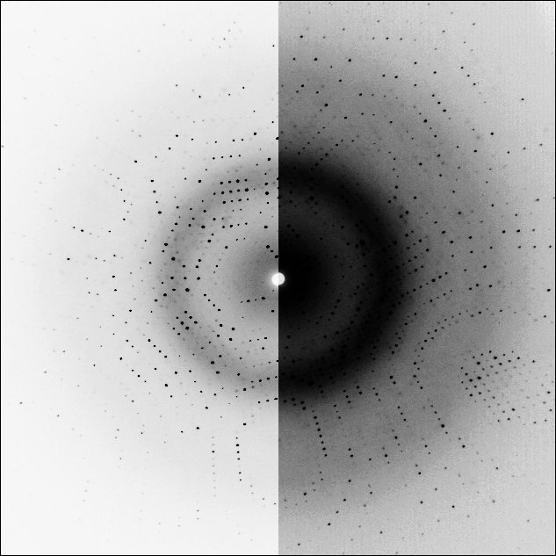
Zones - example
Crystal rotated
(a little)

Slide 48
Moving the crystal
Still crystal → few spots on each ellipse
Rotate crystal
Red regions pass through Ewald sphere
Additional reflections seen

Slide 49
Diffraction of moving crystal
All spots between ellipses between
Start of rotation
End
Regions of reflections = “lunes”

Slide 50
Lunar or spatial overlap
Wide rotation
Fat ellipses
Many reflections from each plane
Planes project to same part of detector
Lunes overlap
Spots may overlap

Slide 51
Avoiding Overlap
Oscillation method
Small rotations
Overlap more w/ finely spaced planes
Large unit cells
Rotations < 0.5°
Typical unit cells
Rotations: 2.5 to 5º
Also depends on
Resolution
Mosaic spread
Precession method
Metal screen
Allows through xrays of one plane only
Circular aperture
Large rotations in all directions
~ All reflections in one plane
Film rotated to be || to crystal plane
Undistorted image of lattice
“Precession”

Slide 52
Rotation or Oscillation Photography
Crystal rotated - small angle, Δφ ⊥ beam; …
10 fast oscillations better than 1 slow rotation:
Averages crystal decay & beam fluctuations
during angular sweep.

Slide 53
Rotate the Crystal or the Generator?
Most prefer to rotate the crystal
Diagrams easier if rotate the laboratory
Equivalent
Ewald sphere at start
End of rotation
Will now focus on parts of planes that have cross the Ewald sphere
O
O

Slide 54
Full and Partial Reflections
Reciprocal lattice points have finite size
Mosaic spread
Whole reflections
Crossed completely by Ewald sphere w/in Δφ.
Partial reflections
On sphere at start or end of rotation
Only part of reflection recorded
Fraction recorded = “partiality”

Slide 55
Structure amplitudes from partials
Measured intensity = F²/partiality
Partiality depends on experiment, not structure
Need to correct
Make equivalent to full reflection
Partiality = 1
Two approaches
Series of contiguous oscillations
Add intensities from successive images
Errors – changing beam intensity etc..
Estimate partiality → mathematical correction
Errors - Requires accurate understanding of crystal orientation
Partial reflections less accurate

Slide 56
Crystal Alignment
Some orientations → more efficient collection
Approximate alignment OK (not like precession)
Determine orientation then re-orient
Center zones from still images
Computer-auto-indexing (details later)
From 1 to 3 still images
No longer necessary to precisely orient before data collection
Some use the American Method
Shoot first – ask questions later
When crystal lifetime in beam is short

Slide 57
Prolonging Lifetime w/ Cryocrystallography
Radiation damage
Reduced at 100 K
Caused by:
Crystal heating
Ionizing radiation → roaming free radicals
Changing covalent structure
Abated by reducing diffusion in ice

Slide 58
Freezing Crystals
Vitreous ice (glass) OK
Ice crystals:
Destroy protein crystal
Add ice diffraction
Must be avoided
Cryo-protection
Antifreeze
Glycerol, PEG, MPD…
Oil coating
Search for one that does no damage
Serial transfer
Reduce osmotic shock
Flash freezing – 2 ways:
Plunge into liq N₂, propane
Then put on x-ray camera
Keeping at 100K
Place on camera at 20º
Quickly start N₂ stream
Maintain in cold N₂ gas stream

Slide 59
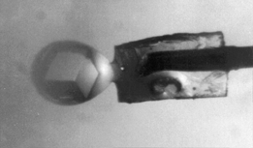
Crystal Mounting
Cryo-data collection
Drop of frozen mother liquor
Held in loop of fiber
Scooped up using surface tension
Open crystal → better heat conduction to liq N₂.
Collection at 4 to 30ºC
In sealed capillary
Maintain humidity
Stop crystal drying
Capillary made of quartz
Minimize x-ray absorption
Cold N₂ stream
Mother liquor
Wax seal

Slide 60
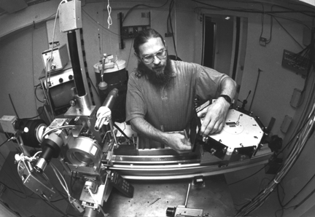
Data Collection Instrumentation - Synchrotron
Cryostream
Video microscope
X-rays
Motor to rotate crystal
Crystal here (honestly!)
Detector (film)
Thanks to Cornell High Energy Synchrotron Source

Slide 61
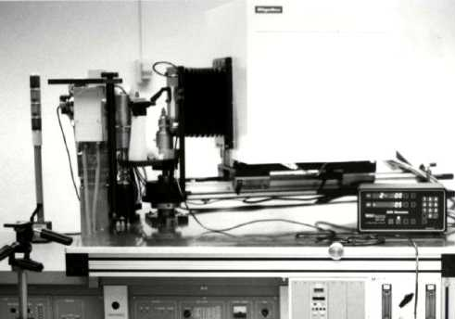
Data Collection Instrumentation
Helium path to minimize air-absorption
X-rays
Motor to rotate crystal
Detector (image plates + automatic scanner)
Thanks to Soma!
Crystal here (honestly!)
Generator

Slide 62
Detectors
Type | Advantages | Disadvantages
Scintillation counter | Most precise | One spot at a time (small unit cells)
Film | Spatial resolution < 50 μm | Background, dynamic range, turnaround time
Multiwire | Precise | Spatial resolution, expense
TV detector |  | Unstable, calibration, expense
Image plate | Size, Medium precision | Scan-time
CCD’s | Precise, dynamic range | Large ones very expensive

Slide 63
Data Processing - Overview
Determine which region contains each reflection
“Indexing”
Orientational refinement
Integrate intensity near reflection center
Subtract background
Scaling:
Correct for factors that don’t depend on structure, but
Geometry of data collection
Shape and absorption of crystal
Merging – symmetry equivalent measurements
Calculate quality statistics

Slide 64
Scaling - Introduction
Calculate image scale constant
Intensities agree w/ symmetry equivalents
Approx. correction for many factors:
Crystal Absorption:
Depends on path length
Depends on crystal orientation and individual reflection.
Other absorption: capillary, solvent -
varies slowly, can be minimized.
Volume of crystal in beam:
depends on φ, therefore image #
Decay due to radiation damage:
depends on resolution and time (→ φ, image #).

Slide 65
Quality of Scaling
Quality of data is now assessable with a scaling R-factor. R_{i} = Σ_{h} Σ_{i} |⟨ I_{h} ⟩ - K_{hi} I_{hi}| / h⟨ I_{h} ⟩
Compare this R-factor to the least-squares residual (or corresponding variance):
Both depend on magnitude of difference.
Residual is squared, so more sensitive to large differences.
R-factor is normalized, and expressed as decimal fraction or %.
R_{i} (R_{sym}) is calculated from intensities.
Most other R-factors are calculated from
|F| = √I.

Slide 66
Quality of Data
R_{i} is used as a measure of data quality:
R_{i} ≤ 3%: excellent.
R_{i} ≤ 5%: typical average protein.
R_{i} ≤ 9%: typical large protein.
R_{i} ≤ 13%: typical virus capsid.
Partial reflections are usually excluded
→ underestimate of error, especially for large molecules (small Δφ, many partials).
Inclusion of partials for virus → R_{i} = 18%.

