Slide 1
Models – Refinement & Validation
Lewis & Clark Workshop
Macromolecular Crystallography
© Michael S. Chapman

Slide 2
Model-Building
Part I – Mostly to be replaced by practical

Slide 3
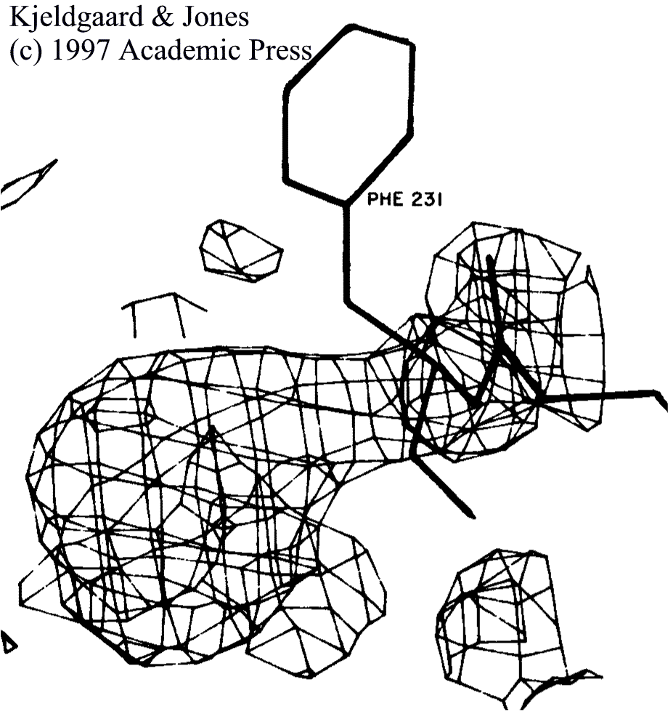
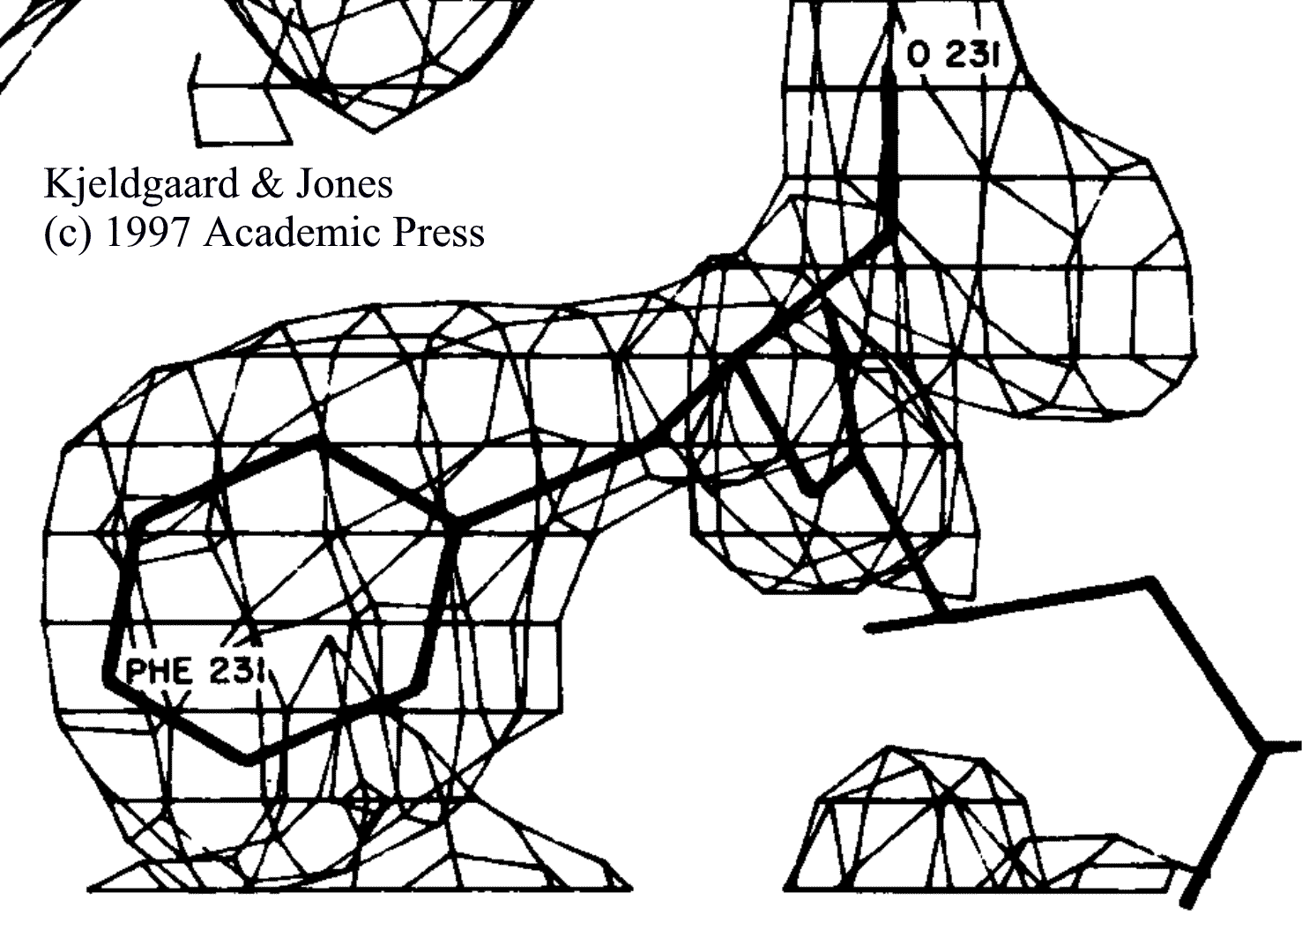
Role
An electron density map is the direct product of a crystallographic experiment
An atomic model is required to understand the chemical implications
Here model fit into the electron density
  “Manual”
    computer-assisted
  Need only be approximate
  Adjusted later- refinement

Slide 4
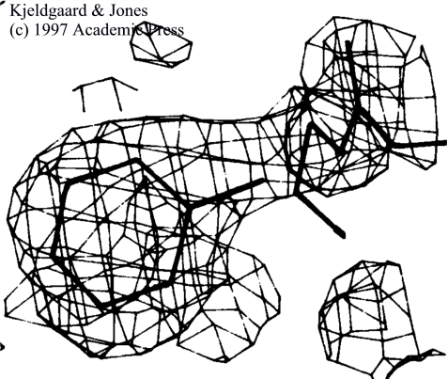
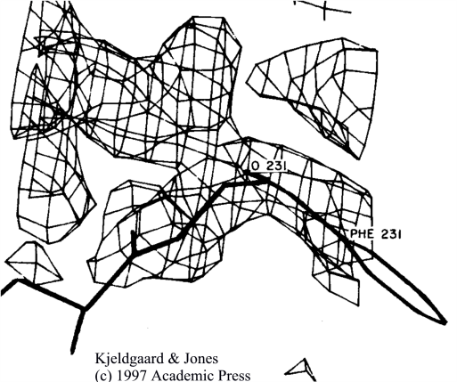
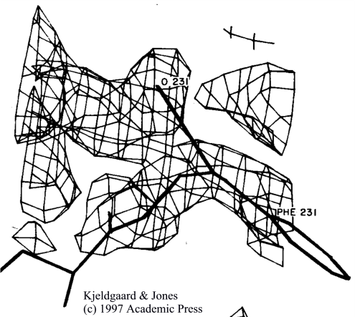
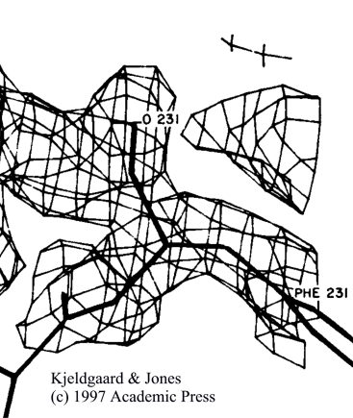
Tools at one’s disposal
Break molecule into fragments
Move fragments as rigid bodies
  Translate, Rotate
  Change rotamer
  Real-space refinement
Geometry regularization
  Restores geometry after fragmenting
  “Refinement”, but not really
  Bond lengths, angles, planarity
  Not
    non-bonded contacts
    variable torsion angles

Slide 5
Data bases – a Powerful Tool
Premise – ain’t nothin’ new”
Almost everything that you see…
  Should have been seen before
  In one of the hundreds of prior structures
If it looks new…
  Most likely a mistake
Not all structures the same!
  but built of common fragments
Tools to find prior fragments that fit density
Especially useful at modest resolution
Program “O”

Slide 6
Programs
Coot – currently most popular
  Paul Emsley
O – still fans. Best database searches
  T. Alwyn Jones & colleagues
Quanta – More automated; Commercial;
  Tom Oldfield et al.
Automation:
Main – D. Turk; Textal – T. Ioerger; Resolve - Terwilliger
Automation
  Best programs do easiest 75% w/ good map
  7 months to complete? / 30% w/in 100 days.

Slide 7
Model-Refinement
Part II

Slide 8
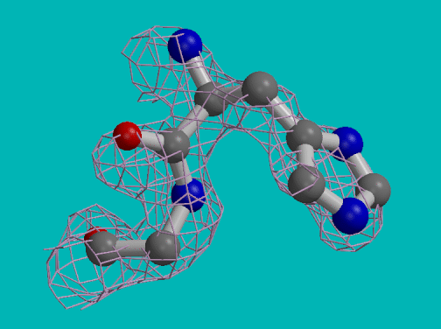
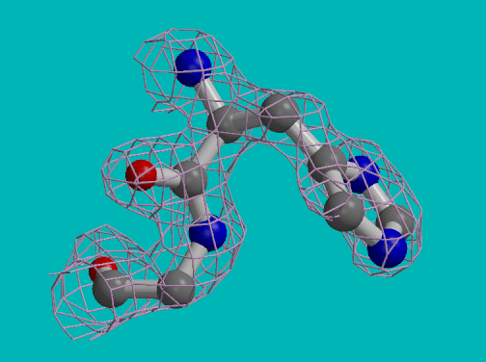
Refinement
Computer optimization of atomic model
Fit to the Experimental Diffraction Data
Agreement with known stereochemical values
  Lengths of bonds…
Minimize (e.g.) U = Σ_{x}(ρ_{o,x}–ρ_{c,x})² + Σ_{r}w_{L,r}(L_{r}-L∅)².
  Fit to density over map grid points, x.
  Deviation from known stereochemistries, L∅.

Slide 9
Objective Function - Type
What we are trying to minimize
Real space: Min Σ_{x}(ρ_{o,x}–ρ_{c,x})² + Σ_{r}w_{L,r}(L_{r}-L∅)².
  Niche-only: density limited by phases
Reciprocal space
  Min Σ_{h}(|F_{o,h}| – |F_{c,h}|)² + Σ_{r}w_{L,r}(L_{r} - L∅)²
  Fit to diffraction amplitudes
  (Optionally phases)
  By far most popular

Slide 10
Objective Functional Form
Minimizing error - Least-squares: Σ(x_{o} – x_{c})²:
  Solution of minimal error
  Errors assumed Gaussian & Independent
  Simpler
  Programs: X-Plor; TNT; ShellX
Maximum Likelihood is better:
  Most likely to be consistent w/ data
  Probabilistic estimates for all errors
  Bayesian statistics / Newer / Complex
  Programs: Phenix; Refmac
  Advantage: Over-fitting reduced

Slide 11
Over-fitting
Fit is too good
  Expected discrepancies:
    Random errors in data
    Missing elements of model – solvent; disorder etc..
Over-fitting when refinement works too well
  Model compensates for errors / deficiencies
Facilitated by global nature of refinement
  Each |F| depends on every atom
  Error (or omission) of atoms in one region compensated by adjustments of other atoms
  “Restoring” good fit between |F_{o}| & |F_{c}|
Monitored by cross-validation – R^{free}.

Slide 12
Need for Stereochemical Restraints/Constraints
Diffraction experiments yield insufficient data to refine unrestrained individual atoms
How many data points?
  Assume (35Å)³ cell at 2.7Å resolution
  10,300 reflections
Atomic parameters
  3,000 atoms x {x,y,z,B} = 12,000 parameters
Under-determined – no unique answer
Perfect data – data pts >= # parameters
Reality – would need Data:parameter ratio > 6:1

Slide 13
Restraints / Constraints improve Data:Parameter ratio
Constraints reduce parameters
Groups of atoms refined as rigid bodies
Reduce parameters
Example Phe side chain
  Individual parameters:
    6 + 1 atoms
    7 x 3 positional params
  Rigid body
    3 angles for orientation
    3 coordinates for center
Restraints increase # “data points”
Penalty for deviation
  (L_{r} - L∅)²
Like adding new datum
  (|F_{o,h}| – |F_{c,h}|)²
Many – 32 in example
  7 bond lengths
  18 bond angles
  6 torsion angles
  1 planarity

Slide 14
Typical Restraints & Constraints embody our a priori knowledge
Typical Restraints
Covalent bond lengths
Bond angles
Fixed torsion angles
  Rings
  Peptide bond
Variable torsion angles
  φ, ψ, χ have optima, but some variation
Van der Waal’s separation
Not usually H-bonds
  Fix structure
Constrained refinement
Fully constrained –
  atomic refinement does not converge as well
  Not flexible enough
Constraints used in
  Rigid-body refinement
    Molecular replacement
  Some in “restrained” refinement
    Chemical Sequence

Slide 15
Ways that Restraints can be Specified
Everything as distances
  Simplest; weighting easiest
  Not very intuitive
  Program Prolsq, SHELLX
As the parameters we use
  Σ_{r}w_{L,r}(L_{r} - L∅)² + Σ_{s} (θ_{s} - θ∅)² + Σ_{s}w_{ΝΒ,n}(d_{s} - d∅)² + …
  Program TNT
As an empirical energy function, e.g. CHARMM
  Σ_{r}k_{L,r}(L_{r}-L∅)² + Σ_{s}k_{θ,s}(θ_{s}-θ∅)² + Σ_{n}k_{NB,n}(A/d¹¹_{n}–B/d⁵_{n})² + …
    Note similarities, minor differences: form, k vs. w…
  Minimize potential energy w/ a new energy:
    E_{xray} = Σ_{h}(|F_{o,h}| – |F_{c,h}|)² (others possible)
  Programs X-plor; CNS; Phenix.refine

Slide 16
How to Weight Stereochemistry
Stronger weight → more ideal stereochemistry
  Less easy to fit diffraction data
What is the correct weight?
  X-plor / CNS: option to calculate weight → ~equal improvement of stereochemistry & fit to diffraction data
  Phenix: minimum R^{free} vs. weight
    Requires ~ 10 cycles of refinement for each point
    Modern computers fast – this is worth doing
Caution – automatic weight determination in CNS is by a lesser method.
R^{free}
log weight

Slide 17
Ways of Finding the Optimum
Gradient descent
Simulated annealing

Slide 18
Gradient Descent
Several methods
  E.g. Conjugate gradient
Principle: at optimum…
  partial derivative of objective function = 0
  δr/δx_{i} = 0
  So, if r = Σ_{h}(|F_{o,h}| – |F_{c,h}|)² + Σ_{r}w_{L,r}(L_{r} - L∅)²
  δr/δx_{i} = 2Σ_{h}(|F_{o,h}| – |F_{c,h}|).δ(|F_{c,h}|)/δx_{i} + … = 0
Determine changes to parameters leading: r → 0

Slide 19
Linear vs. Non-linear Refinement
Linear
Optimal parameters can be calculated immediately
Requires that parameters are independent of one another
Non-linear
Parameters are inter-dependent
Partial derivative with respect to one parameter depends on parameters of other atoms
  Overlapping electron density
  Atoms linked by chemical interactions
  |F| depend on all atoms
Two practical implications
  Solve only for shifts that improve r
    Iterate to progress towards optimum
  Local minima

Slide 20
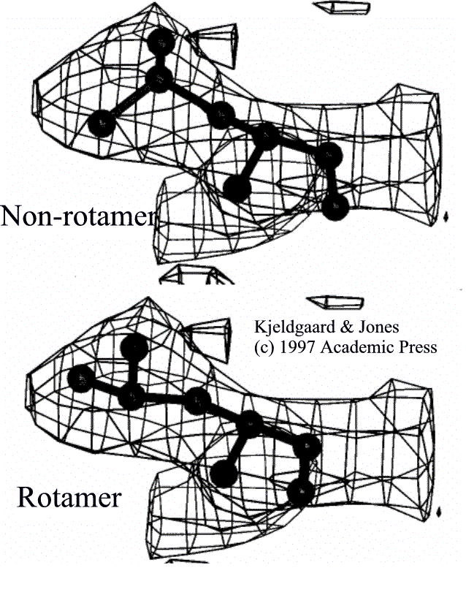
Local Minima
S
G = global optimum
L might be a model that fits reasonably, but perhaps
  Not as well as G
  Or with worse stereochemistry
Rotation about χ₂ might make the fit or stereochemistry
  Worse (M) before better
Gradient descent does a good job of getting from S to L
But can never go up-hill to find a better optimum
U
L
M
G

Slide 21
Moving from Local to Global Minima
Rebuilding using Interactive Computer Graphics
Simulated Annealing & Molecular Mechanics
  Each atom is given a random initial velocity
    Mean velocity corresponds to a temperature
      3,000 to 10,000 K.
  Atoms interact, changing each other’s trajectory
  Determined by solving Newton’s equation of motion repeatedly over short time intervals
  E is energy
  ∇ is directional gradient

Slide 22
How does Molecular Dynamics help?
Atoms are moving
Kinetic energy can be converted to potential energy
Can overcome an energy barrier to find global minimum
Time spent at each minimum depends on depth
  Chance that could move away from global minimum
  But less chance than moving from local minimum.
U
U

Slide 23
Annealing Schedules
Initial velocities simulate T = 3-10,000 K
Energy withdrawn to simulate drop to 290 K
Slow cooling – steps of about 25 K
  Energy gradually falls below that needed to escape deep minima
  While still sufficing to escape local minima

Slide 24
Coordinate Systems
Most refinement programs in Cartesian space
  Atoms move in straight lines
Torsion angles are the primary determinants of structure
  Changes – move atoms in arcs
Cartesian approx limits step size
  Improved fit balanced by worse stereochemistry
CNS; X-plor; Phenix (?) support torsion angle refinement
  More efficient w/ poor models
Effect of torsion angle
Effect of torsion angle
Cartesian change moves through bad stereochemistry

Slide 25
Programs & their merits
TNT - Restrained least squares
  Efficient & Very easy to understand
  Tronrud, Ten Eyck & Matthews
SHELXL – High resolution; only one for Anisotropic B’s
  George Sheldrick
X-plor → CNS → Phenix - Axel Brünger; Paul Adams et al.
  Least squares or Maximum Likelihood
  Simulated annealing or Conjugate gradient
  Cartesian or Torsion angle (?)
  Empirical energy
REFMAC - Murshudov, Vagin & Dodson
  Fast, Maximum likelihood
Most popular are Phenix and RefMac

Slide 26
Refinement is a Process as well as a Program
Refinements good at local optimization
  Rarely find global optimum
  Parts where locked in local optimum
Need to alternate
  Automatic refinement
  “Manual” rebuilding using computer graphics
Focus on regions of:
  Poor stereochemistry – fighting the fit
  Poor fit to density
    Usually use improved map with phases calculated from the latest model
Usually 3 or 4 turns of refinement & re-building

Slide 27
Model-Phased Maps
Part III

Slide 28
Context
Phases calculated from a refined model are better than most experimental phases
Rebuilding in an improved map:
  Can indicate how to escape local mimima
  Parts not yet modeled
    Ligands
    Disordered regions...
Premise: each F is a wave extending thro’ all map:
  Has phase input from all atoms
  Good regions of model help map in poor regions

Slide 29
Credits
Following illustrations are taken from
Kevin Cowtan’s Book of Fourier
  http://www.yorvic.york.ac.uk/~cowtan/fourier/fourier.html

Slide 30


Introducing Felix
A cat – that has a tail
  But hasn’t yet found it…
Manfred the Manx – who never had a tail
Can we reveal the tail fr. image calculated w/
  Felix’s Fourier amplitudes
    Tail and all
  Manfred’s phases
    No tail

Slide 31
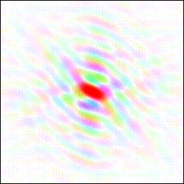
Illustrations of Fourier Transforms
Brightness indicates amplitude
Color indicates phase
FT

Slide 32
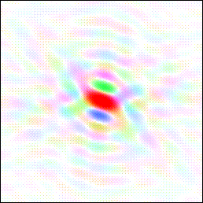
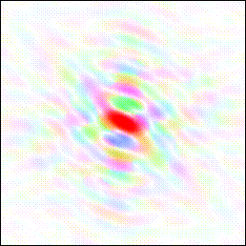
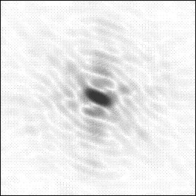
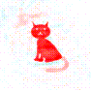
Can we Find the Missing Tail?
Model
FT
φ_{manx}
Diffraction
FT
FT
|F|_{Felix}
Monochrome, ‘cos missing phases

Slide 33
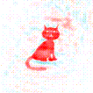
Picky-picky – the tail is weaker
Jensen showed that phases account for ½ of map
Body should be twice as strong as tail
  Body “in” |F| & φ
  Tail only in φ.
Solution – subtract ½ a body (Fourier)
  |F_{Felix}| - ½|F_{manx}|, φ_{manx} = “2Fo – Fc”

Slide 34
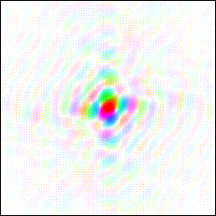

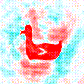
Potential for Bias if Phasing Model Wrong
Suppose we collected diffraction for a cat
But thought that it was a duck…
Model
FT
FT
φ_{duck}
Diffraction
FT
|F|_{Felix}
Model phases → misleading image.
Never know that really a cat.

Slide 35
Potential for Bias – or - Disaster…
Poor initial map → incorrect model
Subsequent maps biased to incorrect model
If you are lucky…
  Does not refine well; R^{free} remains high
  Indicates a potential problem
    Somewhere
May be little indication of where the problem is.
Not so lucky examples:
  Carboxypeptidase: Bill Lipscomb
  RuBisCO: Chapman…

Slide 36
Remedies
Difference map: (|F_{o}| - |F_{c}|, φ_{calc})
  Shows differences between:
    What the model should be
    What it currently is
  Negative peaks where model shouldn’t be
  Positive peaks where should be more model
  Difficult to interpret when noisey
2Fo-Fc maps
  Only a minor improvement – still biased
  2mFo – DFc maps – better (& fast)
Omit maps

Slide 37
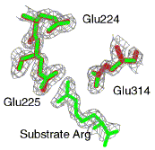
Omit maps
Map small piece of structure (3-5%)
  Covering a few residues
  Or a small box
Phases calculated from structure omitting atoms near this region
Procedures for automatically assembling many small maps → complete structure
Should be unbiased…
  Better, but still can be biased

Slide 38
Bias in Omit Maps
May be several ways of changing cat to make consistent with phaseless amplitudes
A big ear might compensate for a wrong tail…
Refine model
Good
match?
FT
Map omitting tail:
Still shows incorrect tail.
Phases calculated from big ear are more consistent w/ incorrect tail than correct one.

Slide 39
Mitigating Bias in Omit Maps
Problem is combination of phasing with
  Refinement against amplitudes
Simulated-annealing omit maps
  Undo (?) bias by refining phasing model w/o omit atoms
  ~100 refinements / cycle – very slow
  Best with Sigma-A weighting
Cycle local real-space model refinement w/ omit phase calculation
  Even more intensive
Big issue w/ structures worse than 2.7 Å
  Higher resolution becoming more common

Slide 40
Model Quality & Validation
Part IV

Slide 41
R-factors: Global Indicators of Quality
R = Σ_{h}||F_{o}| - k|F_{c}|| / Σ_{h}|F_{o}|
  k is scaling constant (function); h = Miller index
Expected values
  0.59 (59%) - randomly placed atoms
  0.30 – 0.50 – OK - for unrefined structure
  > 0.30 (refined) – incorrect structure
  0.25 – 0.3 – 10-20% structure wrong
  0.20 – 0.25 – a few problems
    1 or 2 frame-shift errors…
  0.15 – 0.20 – great model
  0 – perfect model – never get there

Slide 42
Imperfect models
Never complete
Missing atoms
  Solvent (always); Others (sometimes)
Disorder
  Reality is population of conformers
  Model usually only most populous
Dynamics
  Local vibrations - Temperature factors
  No models of large correlated motions
Deficiencies combining - R almost never < 0.12

Slide 43
Problems with R-factors
Global – no indication of where the error is
Biased by over-fitting
Unit-less – what is the Å error?

Slide 44
Local Index: Real-space R-factor / Correlation
R_{real space} = Σ_{x}|ρ_{o} – kρ_{c}| / Σ_{x}|ρ_{o} + kρ_{c}|
Compares electron density values at map grid points near…
  Selected atoms
  Problems:
    Electron density depends on inaccurate phases
    At end of refinement, phases from model
      Biased

Slide 45
Local Index: Temperature Factors
B = 8 π² <u²>
  <u²> is mean square displacement of vibration
B also reflects model quality
If atoms stuck in wrong place...
  Poor agreement w/ diffraction data
  High B smears out the atom
    Better agreement w/ diffraction
B-values reflect quality, motion & static disorder
  Subjective interpretation of which applies

Slide 46
Stereochemistry – indirect measure of quality
Protein refinement is “restrained”
  Simultaneously improving
    Fit to diffraction
    Agreement with known stereochemistry
Often, when atoms are stuck in local minimum...
Improving fit balanced by deteriorating stereochemistry
Poor stereochemistry can be used to highlight problems

Slide 47
RMSDs – A global indicator
Root mean square deviations
  From expected geometry
Expected RMSDs for a reasonable structure
  Bond lengths < ± 0.02 Å
  Bond angles < ± 2.5º
  Peptide torsion angle ω < ± 7º
  Side chain torsion angles χ < ± 15º
  Non-bonded contacts < ± 0.1 Å

Slide 48
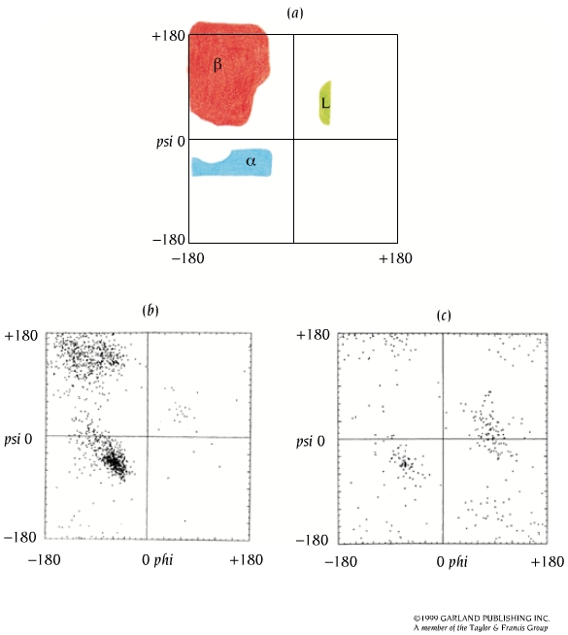
Maximum deviations – a local indicator
Sites of greatest fighting:
  Fit to diffraction vs. stereochemistry
  Are likely sites of errors in model
All types of geometry should be monitored
  Procheck – Laskowski; MolProbity - Richardson²;
  Phenix.refine; Coot...
Unrestrained geometry is most sensitive
  φ,ψ (Ramachandran) most useful – if not restrained
Branden & Tooze
© 1999 Garland

Slide 49
More problems w/ R-factors
R= Σ_{h}||F_{o}| - k|F_{c}|| / Σ_{h}|F_{o}|
r = w Σ_{h}(|F_{o}| - k|F_{c}|)² + U_{stereochemical}
Minimize r – tend to reduce R
R measures fit of model to x-ray data
  Not an independent measure of model quality
Over-fitting
  Results in R being too optimistic
  Because # model parameters > expt data points
  Occurs when w too large
    Insufficient weight on standard stereochemistry

Slide 50
R-factors – Measure Goodness of Fit
Simple analogy – fitting line to data…
R-factor could be used to quantify fit of line.
  Similar to coefficient of regression
Sum of distances:
  Data to model
  “Model” is straight line

Slide 51
Improving R (Goodness of Fit)
2) Make model more flexible:
Add parameters:
y = ax + c → y = ax²+ bx + c
Adding H₂O, Bs etc.
Relaxing stereochemistry
3) Discard data
Easier to fit, but worse model
1) Improve the model (change the line)

Slide 52
R-factor must be evaluated in context
How many data points for each parameter?
  Data points depend on inverse cube resolution
  Can refine fewer parameters at low resolution
Were the stereochemical restraints too flexible?
  Rmsd bond lengths ~ 0.01 Å, angles 2.5°…
    Tables of such parameters
  φ,ψ – Ramachandran plot

Slide 53
Cross-validated “free”-R-factors
Set aside 3-10% data
  Selected randomly
  Never used in refinement
Only used to assess quality of model
  Calculate R_{free} against only this data
Not refined, so independent of stereochemical restraints, # data etc..
Indicator of model quality.
(1 to 5% Higher than conventional R-factor)
R_{free} < 30% means structure approx. correct

Slide 54
Estimated Standard Deviations (Å)
None of the methods above → error bars for each atom
Least-squares refinement can → e.s.d.s
  Only w/ “full matrix” refinement
  High resolution, small structures
  Usually have to diagonalize normal matrix
Usually can only estimate average coordinate error
  From expected discrepancy of |F_{o}| & |F_{c}|

Slide 55
Estimating overall error
Two related methods
  Luzzatti plot
  Sigma-A plot “σ_{A}”
Common principle
  Given coordinate error →
  Dependence of ||F_{o}| - |F_{c}|| on resolution
Differences
  Luzzatti assumes errors only in position
  Sigma-A plot accounts for missing structure

Slide 56
Luzzatti Plots (1954)
Calculate expected R vs. resolution
  Read 1/2d = sinθ/λ for resolution
  Straight lines
Plot R vs. resolution for your structure
Match at high resolution
  Nearly linear – hopefully
R_{free} better than R
0.3
<Δr> = 0.16Å
R
0.2
<Δr> = 0.12Å
0.1
<Δr> = 0.08Å
sinθ/λ
0.1
0.2
Sigma-A plot conceptually similar
More complicated
Usually similar estimates

Slide 57
Typical error levels
Values depend on
  Quality of refinement
  Resolution of refinement
Values to hope for
  Refinement resolution <|Δr|²>
  3 Å 0.5 Å
  2 Å 0.2 Å
  Better than 1 Å 0.05 Å

Slide 58
Conclusion – topics for another day...
Intelligent analysis of structure / function
  Appreciation for the limitations in structures
Crystallographic methods for complexes
Methods for physical / chemical properties
Biological inferences
  Conservation of structure & function
Extrapolations
  Energy minimization & Docking
  Dynamics
Prediction of Function & Mechanism

